Slide 1
Lesson objective
Title: Multiplying with decimals
Aim:
Perform written strategies to multiply decimals
Plan:
Daily review
6 times table
Multiply decimals

Slide 2
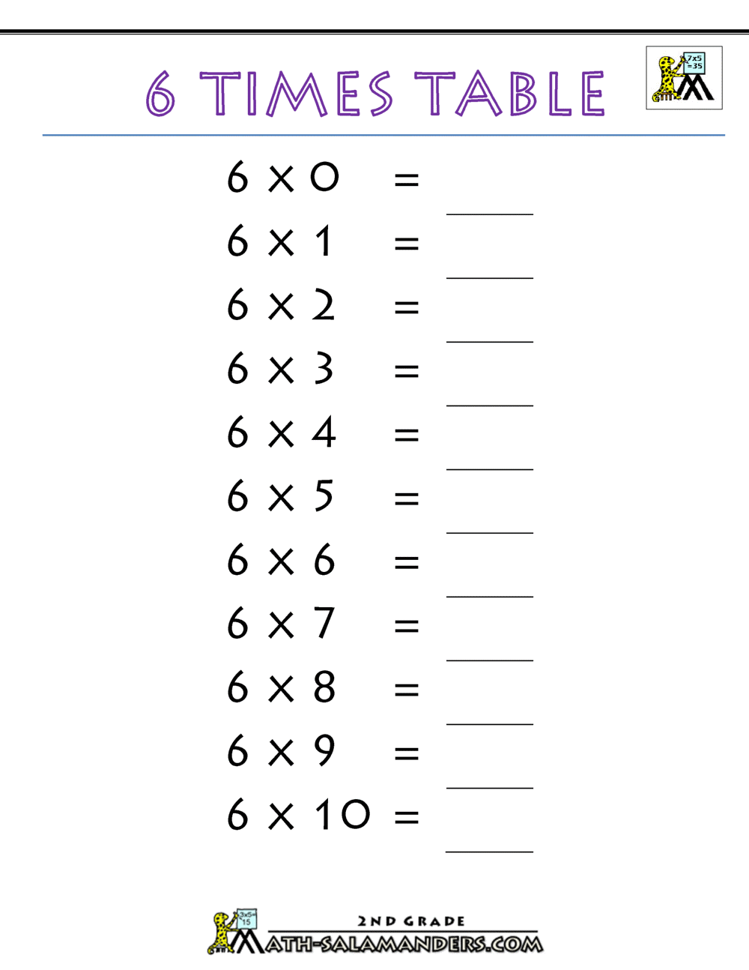

Daily review
On your whiteboards
3 – (-4) =
(-17) + (-5) =
$\left(−10\right)÷2=$
7 x (-3) =
430 – (-45320) =

Slide 3
Lattice method: decimals
The number of decimal places in the question must equal the number of decimal places in the answer.
The number of decimal places in the question _________the number of decimal places in the answer.
The question has 4 decimal places, how many decimal places will be in my answer?

Slide 4
Multiplying decimals
I do
We do
3.2 x 1.2 =
4.56 x 1.3 =
1.5 x 2.3 =
2.43 x 2.5 =

Slide 5
Whiteboard
Use the lattice or grid method for this question:
127 x 34 =

Slide 6
Multiplying decimals.
The number of decimal places in the question must equal the number of decimal places in the answer.
 | Number of decimal places in question | Answer
12.7 x 3.4
1.27 x 3.4
0.127 x 34
127 x 0.34
0.127 x 0.34
0.0127 x 3.4
Notes:
Worksheet 2

Slide 7
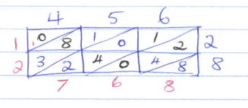


Independent practice:
eg: Calculate 4.56 x 2.8
$$∙$$
Calculate each of the following, in your exercise books:
4.7 x 2.6
3.9 x 54
2.34 x 6.7
0.59 x 1.8
0.621 x 27

